Slide 1
Artemis Consulting
Approach to Open FDA prototype website

Slide 2
High level goals (Cont’d)
Front-end development
Mobile-first design
Responsive design
Utilize open-source frameworks
Use out-of-the-box graphical design themes
Ensure proper visualization tools are utitilized to present large amounts of information
Ensure cross-browser compliance
Ensure use of automated test tools and suites
Back-end development
Utilize open-source frameworks
Ensure writing and running of unit tests
Incorporate scalability through redundancy, web and application caching, and ability to scale horizontally
Utilize persistent storage as needed
Ensure exception handling scenarios are handled
DevOps
Ensure continuous integration and deployment approaches are implemented in Sprint 0
Ensure continuous monitoring is done for all application and infrastructure components
Implement backup and redundancy for all application components
Open sourcing
Use open-source tools and techniques
Provide an open-source license and code that can be deployed and used as-is by all

Slide 3
High level goals
We have a week to do UX, design, build, test, perform user testing and deploy
Approach
Follow the Digital Services Playbook
User and requirements development
User Surveys
Personas
User Interviews
User stories
User journeys
User Testing
Test prototype with real users at the end of every sprint
Incorporate feedback into future user stories
Agile delivery
Well-maintained and groomed backlog
Focus on MVP
4 development sprints

Slide 4
Tools and Techniques
User Centric Design
Personas
Journeys
Stories
Agile Process
Taiga.io for stories, sprints and releases
Front-end development
Django templates
JavasScript/jQuery
Bootstrap/Bootswatch Paper theme
Highcharts chart and mapping widgets
Accessibility
Back-end development
Apache
Python
Django
Memcached
Postgres
Testing
Selenium
Django testing framework
DevOps
CloudFoundry Hosting for Development/Continuous Deployment
Amazon Web Services for prod
CloudBees Jenkins for Continuous integration and Continuous deployment
Nagios for monitoring

Slide 5
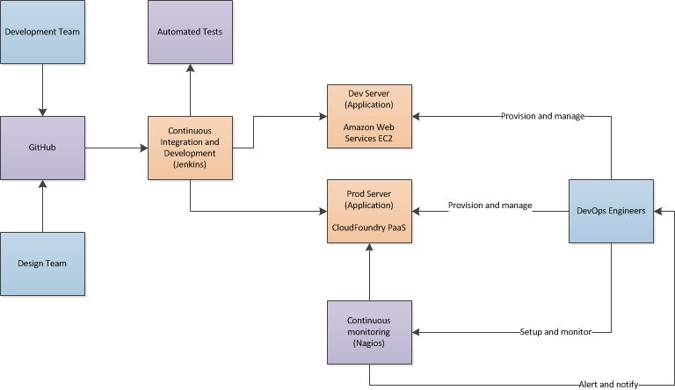
General Approach

Slide 6
Overall design approach steps
Kickoff
Assemble team and define roles and responsibilities
Discovery
Determine problem domain
Review available data sources
User personas and journeys
User Stories
Define initial user personas
Define final user personas
Define initial user journeys
Define final user journeys
Define initial user stories
Agile prototyping
Add additional user stories
Perform user testing and validation
Analyze user testing results
Perform user testing
Define user testing scripts
Define changes to prototype and add additional user stories

Slide 7
Overall development and deployment approach steps
Kickoff
Assemble team and define roles and responsibilities
Development and Testing
Production deployment
Sprint n
Sprint 1
…
Hardening Sprint
Release
Sprint 0
Set up
Continuous deployment, using Jenkins
Continuous integration, using Jenkins
Launch!
Setup Jenkins for production deployments
Set up unit test automation
Create development container, using Docker
Set up monitoring, using Nagios
Set up security controls, and continuous monitoring

Slide 8
Output
Documented users, personas, user stories and user journeys
Accessible website
Mobile-friendly website using responsive design principles
User interviews done with doctors and lawyers which were used to create and implement new stories in future sprints
Release 1 of “FDA Drug Monitor” website
Open source deployable and runnable code with instructions, Docker container and complete front-end and back-end code.
Additional stories completed.
Release 2 of “FDA Drug Monitor” website
Story backlog with more stories that can be implemented in future releases

